Slide 1
Arrays in Java Lecture - 12

Slide 2
Contents
Methods
Parameters passing
Returning Multiple values
Throwable fillInStackTrace() method in Java

Slide 3
Methods
Method is a collection of instructions performing specific task.
It provides reusability of code.
The method is executed only when we call or invoke it.

Slide 4
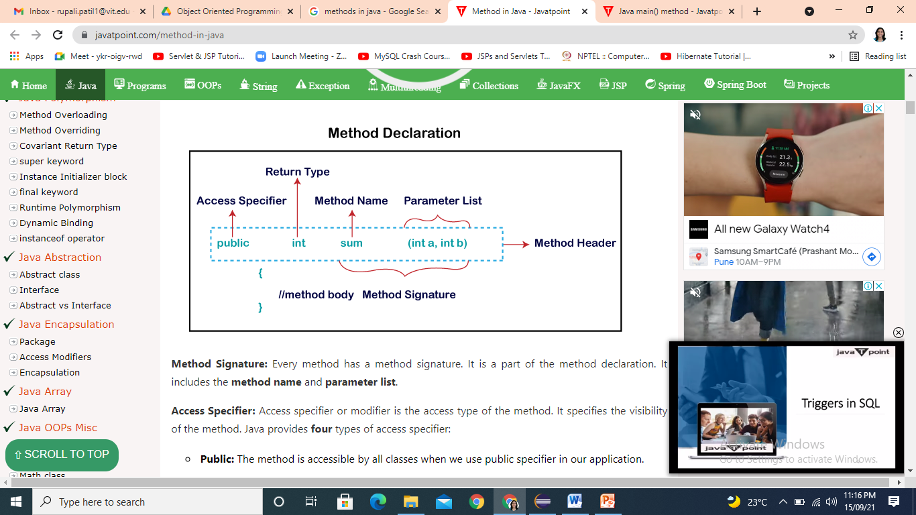
Method Declaration

Slide 5
Types of Methods
Predefined Method
Predefined methods are the methods those are already defined in the Java class libraries.
User-defined Method
The method written by the user or programmer is known as a user-defined method.

Slide 6
Parameters passing
Caller function
Called function or callee function
Types of parameters:
Formal Parameter
Actual Parameter
Pass by value or call by value
Call by reference
Passing Object to function

Slide 7
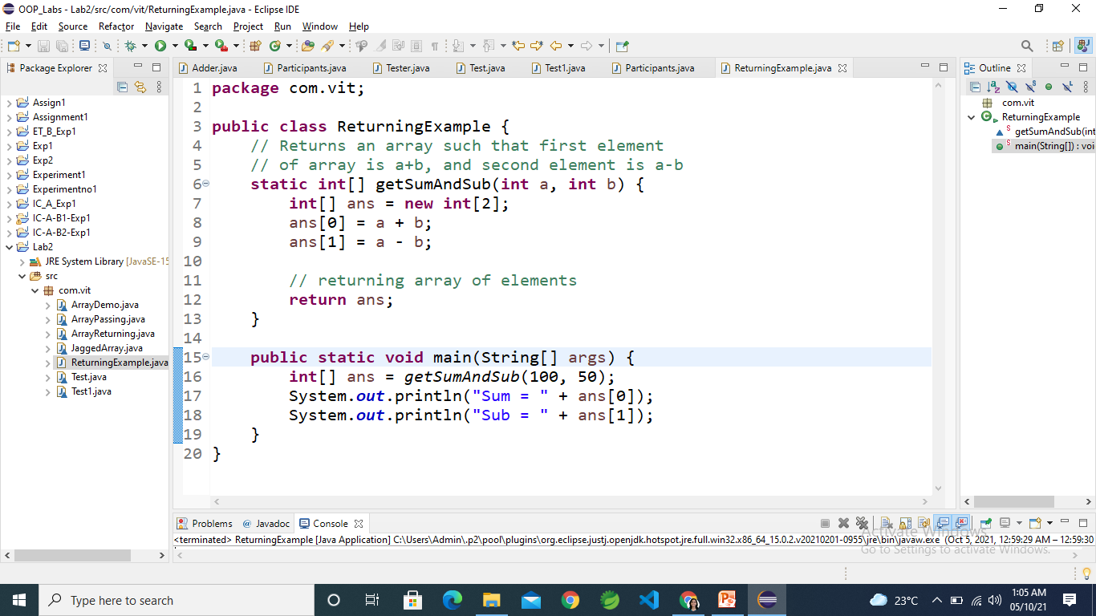
Returning Multiple values
Java doesn’t support multi-value returns.
If all returned elements are of same type then we can return an array.
Example

Slide 8
Throwable fillInStackTrace() method in Java
The fillInStackTrace() method is present in java.lang.Throwable class.
It records information about the current state of the stack frames.
Using this method one can see the Exception messages.

Slide 9
Contents
Valid variants of main()
Variable Arguments (Varargs) method

Slide 10
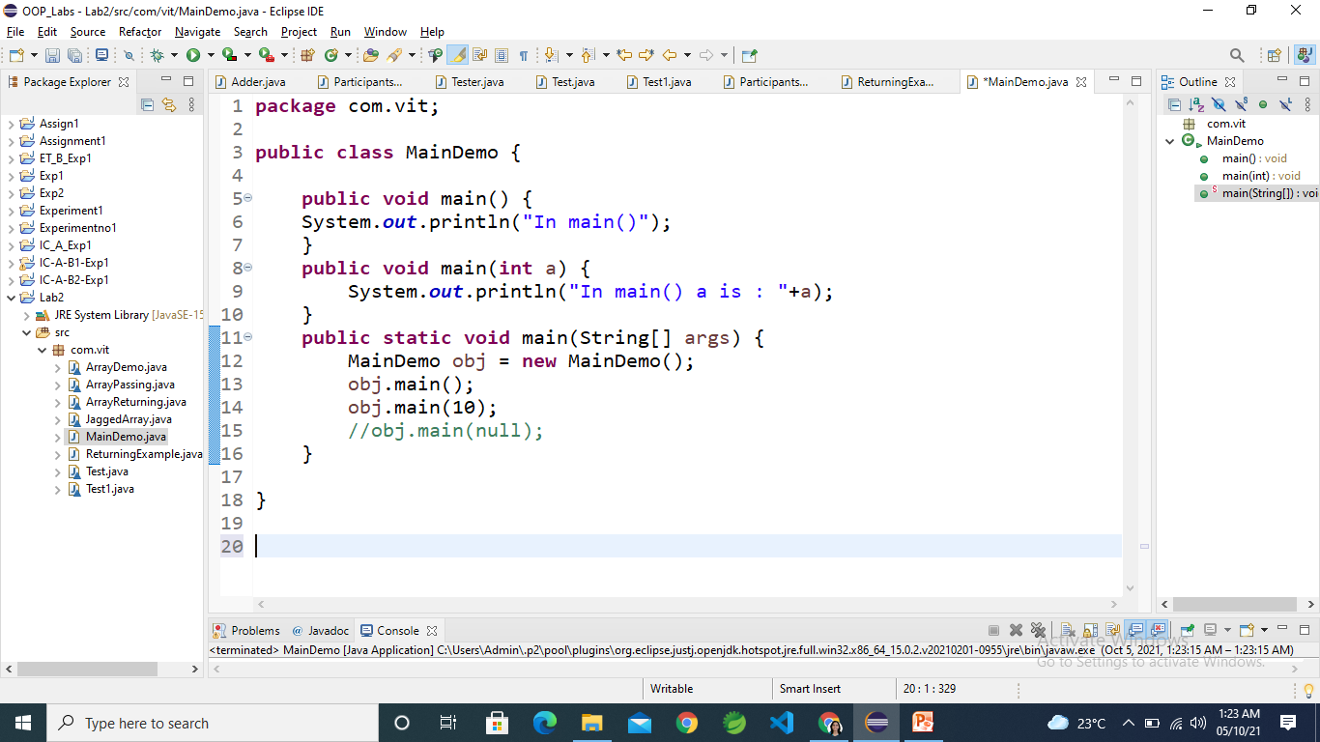
Valid variants of main()
One can overload main() function like ordinary functions in Java.
Class should have one main() function of type:
public static void main(String []args){
}

Slide 11
Variable Arguments (Varargs) method
Java has included a feature that simplifies the creation of methods that need to take a variable number of arguments
It is short-form for variable-length arguments.
A method that takes a variable number of arguments is a varargs method.
A variable-length argument is specified by (…)
Example

Slide 12
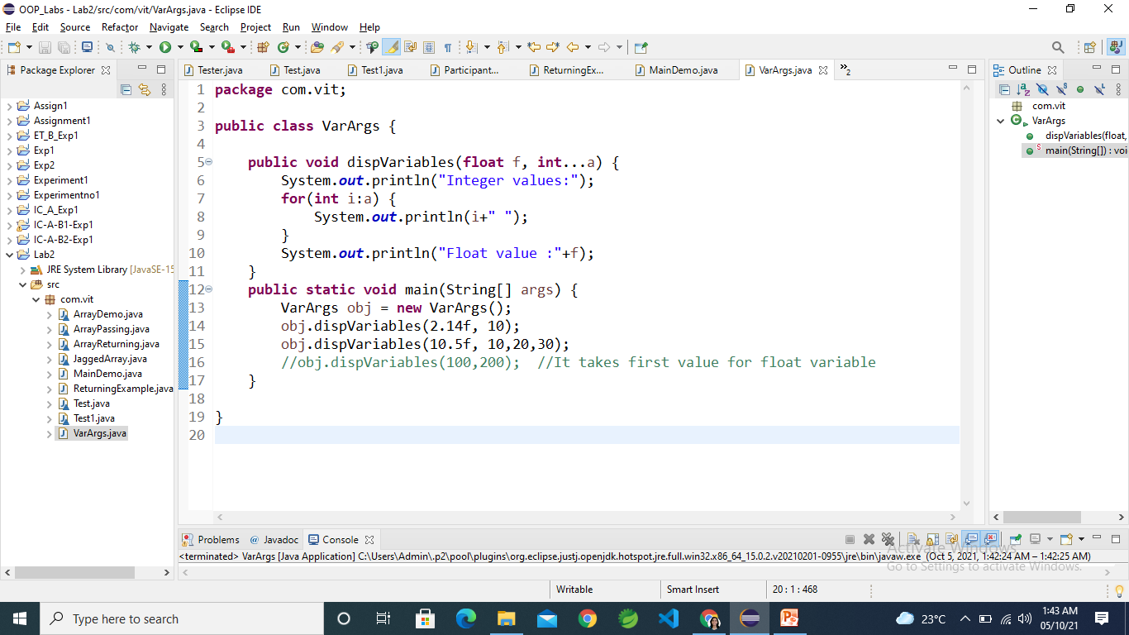
Variable Arguments (Varargs) method
Example

Slide 13
Thank You

